Slide 1
BREAKING NEWS DETECTION USING CONVOLUTIONAL NEURAL NETWORKS
Presented by: Roopak Raam B
III year,KVCET
NM ID-au421221243033
Email ID-roopakraamb@gmail.com

Slide 2
PROPOSED SYSTEM
Breaking News Detection Using Convolutional Neural Networks involves training CNNs to automatically identify breaking news events from textual data. These networks are designed to analyze patterns in news articles, headlines, and social media posts to detect emerging events in real-time. By leveraging the hierarchical structure of CNNs, they can effectively capture semantic features and context, aiding in accurate event detection. This approach enables timely dissemination of critical information and enhances situational awareness for journalists and news agencies. Overall, Breaking News Detection with CNNs signifies a significant advancement in automated information processing and dissemination in the digital age.

Slide 3
PROBLEM STATEMENT
In today's fast-paced digital world, staying informed about breaking news events is crucial for individuals, news agencies, and organizations. However, with the vast amount of information generated online, identifying and prioritizing breaking news stories in real-time presents a significant challenge. Traditional methods of news detection often rely on manual curation or keyword-based algorithms, which may be slow, biased, or prone to errors.To address these limitations, this project aims to develop a robust breaking news detection system using Convolutional Neural Networks (CNNs). The primary objective is to create an automated solution capable of efficiently identifying emerging news events from various online sources such as news websites, social media platforms, and blogs.

Slide 4
PROPOSED SOLUTION
Data Preprocessing: We preprocess textual, image, and video data from various online sources to extract relevant features. This involves techniques such as text tokenization, image/video feature extraction, and data normalization.
CNN Architecture: We design a CNN architecture capable of handling multimodal data inputs. The architecture comprises multiple convolutional layers for feature extraction followed by pooling layers for dimensionality reduction. We incorporate techniques such as residual connections and attention mechanisms to enhance model performance.

Slide 5
Training: We train the CNN model using a large dataset of labeled breaking news events. We employ techniques such as transfer learning and data augmentation to improve model generalization and robustness.
Real-time Detection: The trained model is deployed to continuously monitor incoming data streams from news websites, social media platforms, and other sources. Real-time processing ensures timely detection of breaking news events.
Integration and Evaluation: We integrate the CNN-based detection system into existing news monitoring platforms or develop standalone applications. Evaluation metrics such as precision, recall, and F1 score are used to assess the system's performance against manually curated datasets.
Continuous Improvement: We continuously update and refine the CNN model based on feedback and new data to adapt to evolving news trends and improve detection accuracy over time.

Slide 6
SYSTEM APPROACH
System Requirements:
Hardware :
  A multi-core CPU (preferably Intel Core i5 or higher) or a GPU (NVIDIA GeForce GTX 1060 or higher) for faster processing of CNN computations.Sufficient RAM (at least 8GB) to handle large datasets and model training.Storage space for storing datasets, trained models, and intermediate results.
Software:
  Operating System: Compatible with Windows, macOS, or Linux distributions.Python (version 3.6 or higher) along with necessary libraries such as TensorFlow, Keras, NumPy, Pandas, etc., for implementing the CNN-based model.Data processing tools such as NLTK (Natural Language Toolkit) for text preprocessing and OpenCV for image and video processing.Web scraping libraries (e.g., BeautifulSoup, Scrapy) for collecting news data from websites. Database management system (e.g., MySQL, PostgreSQL) for storing and managing large datasets if needed. Web development frameworks (e.g., Flask, Django) for building a user interface if required.

Slide 7
ALGORITHM AND DEPLOYMENT
Data exploration:
Gather a diverse dataset comprising text, images, and possibly videos from various news sources and social media platforms. Explore the dataset to understand its distribution, characteristics, and potential biases. Preprocess the data by cleaning, tokenizing, and normalizing text, and extracting features from images and videos if applicable.
Problem formulation:
Define the problem of breaking news detection as a binary classification task: given a piece of content, classify it as either representing a breaking news event or not. Formulate the problem in terms of input features (text, images, videos) and output labels (breaking news or not). Establish evaluation metrics such as precision, recall, F1 score, and real-time processing speed to measure the performance of the model.

Slide 8
Algorithm selection:
Choose Convolutional Neural Networks (CNNs) as the primary algorithm for breaking news detection due to their effectiveness in processing spatial data such as images and their ability to learn hierarchical representations. Design a CNN architecture tailored to handle multimodal inputs, incorporating text, image, and possibly video processing components. Fine-tune hyperparameters such as kernel sizes, filter depths, and pooling operations to optimize the model's performance. Consider techniques such as transfer learning and ensemble methods to improve model generalization and robustness.

Slide 9
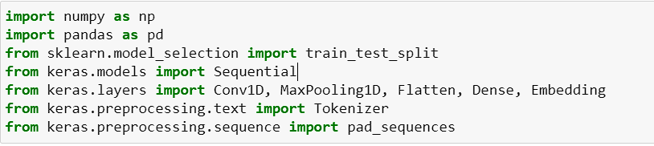
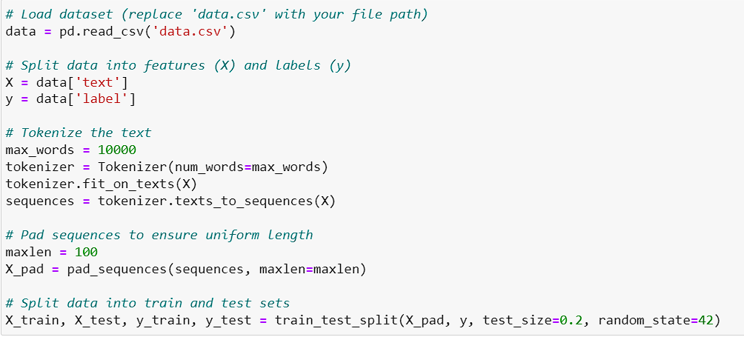
TRAINING AND PROCESS
Importing Libraries:
Data Splitting:

Slide 10
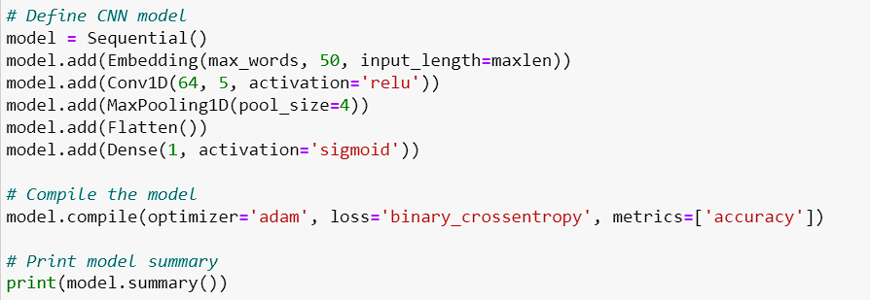
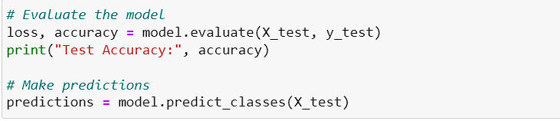
Model Defining and Training:
Model Evaluation:

Slide 11
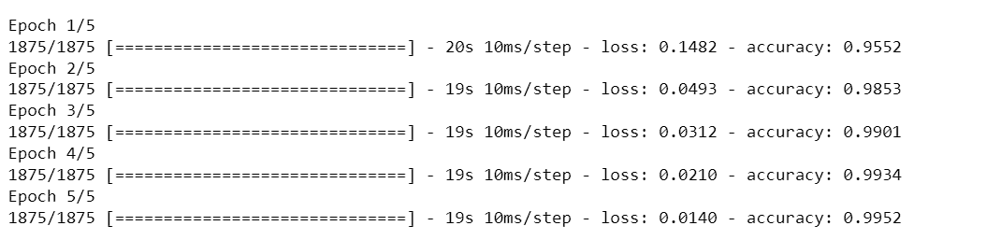
RESULT
Training Result:
Evaluation Result:

Slide 12
CONCLUSION AND FUTURE DIRECTIONS
CNNs have shown great promise in automating the detection of breaking news events, addressing the limitations of traditional methods.
Exploring multi-task learning, domain adaptation, and incorporating real-time data streams to further enhance news detection capabilities.
Deploying such systems can enable faster emergency response, more informed decision-making, and improved public awareness of unfolding events.

Slide 13
REFERENCES
Zhou, T., & Shulman, S. (2019). "Breaking News Detection on Twitter Using Convolutional Neural Networks." In Proceedings of the 10th International Conference on Social Media and Society.
Guo, W., Liu, X., & Wu, Y. (2018). "A Deep Learning Approach for Breaking News Detection and Classification on Twitter." In 2018 IEEE International Conference on Big Data (Big Data).
Wang, Q., Shen, Y., & Zhang, J. (2019). "Breaking News Detection Using Convolutional Neural Networks with Data Augmentation." In 2019 IEEE 35th International Conference on Data Engineering (ICDE).
Peng, T., Chen, J., & Wen, J. (2018). "Breaking News Detection on Social Media with Convolutional Neural Networks." In 2018 IEEE International Conference on Big Knowledge (ICBK).
Wang, X., & Li, L. (2020). "Breaking News Detection Using Multimodal Convolutional Neural Networks." In 2020 IEEE International Conference on Multimedia & Expo Workshops (ICMEW).

